Slide 1
Another LR(1) Grammar
S -> HP$
H -> d
H -> drg
P -> tP
P -> mn
FSM, Goto table, Action table
Walkthrough: dttmn

Slide 2
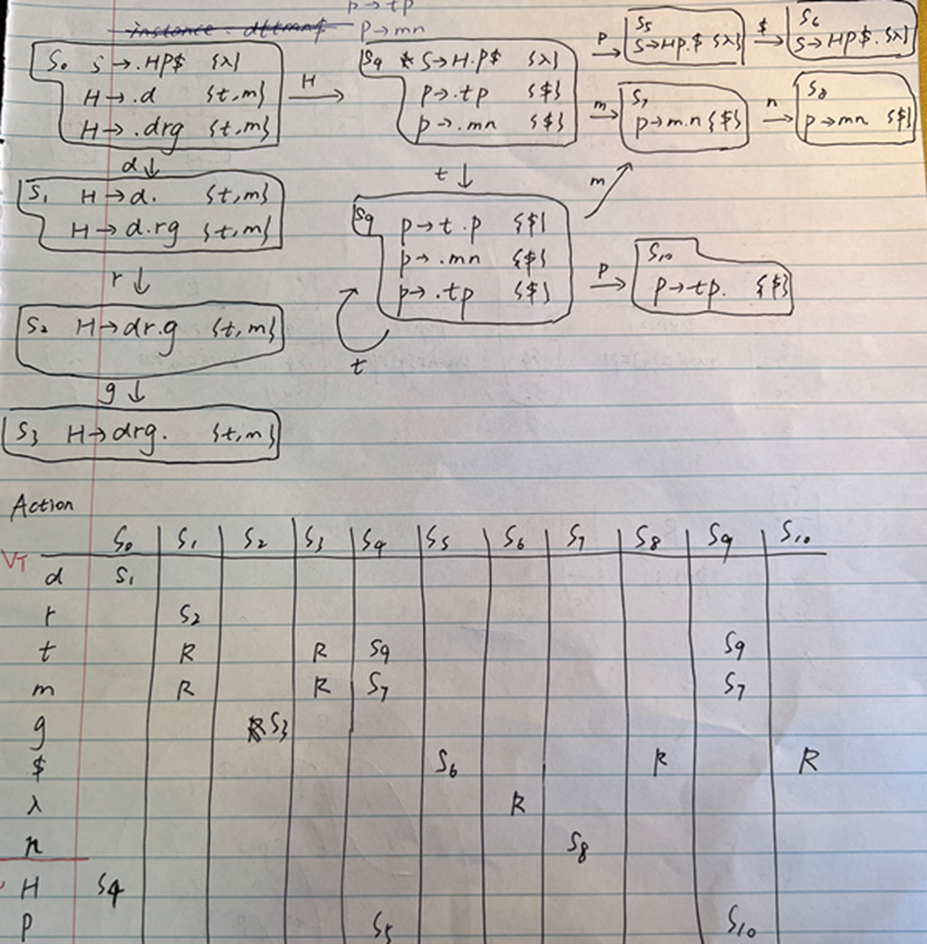
Action Table

Slide 3
Another LR(1) Grammar
S -> G r P $
G -> Q
G -> Q a d
Q -> h
P -> g
Create the FSA, goto table, and action table. Show how you would use these tables to parse hadrg$
Notes:
Show we need LR(1) – then get them to do it...
<νυμβερ>

